Slide 1
Convolution Module

Slide 2
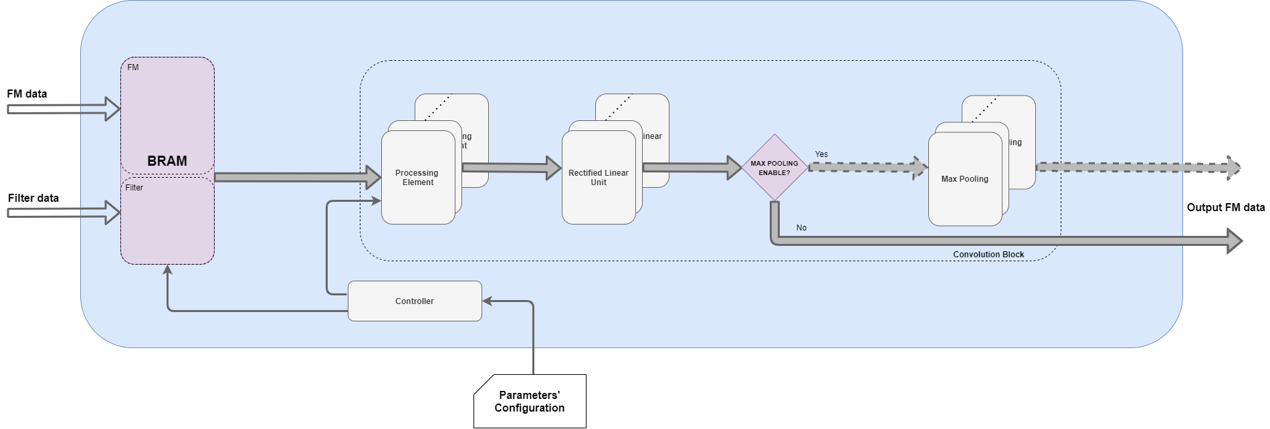
Module architecture

Slide 3
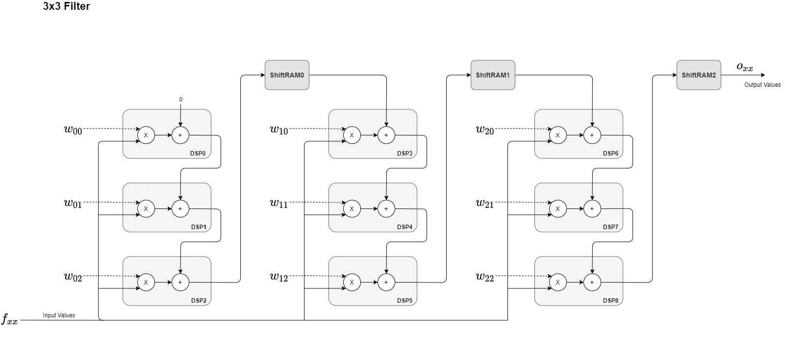
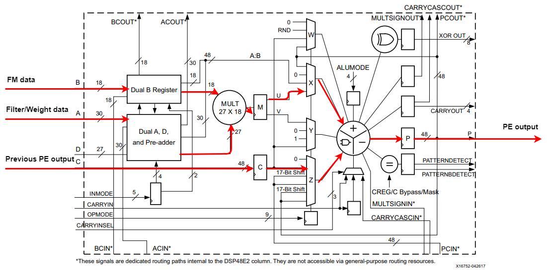
Processing Element
3x3 filter
Processing Element configuration for a filter application of 3x3
DSP Internal Block Diagram

Slide 4
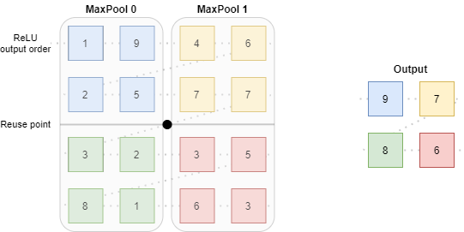
Max Pooling
Number of MaxPooling blocks depend on the IFM size
In this example, the output of the ReLU is a 4x4 FM, so 2 MaxP blocks are instantiated
Both blocks are reused after the first output line have been processed (values 9 and 7)

Slide 5
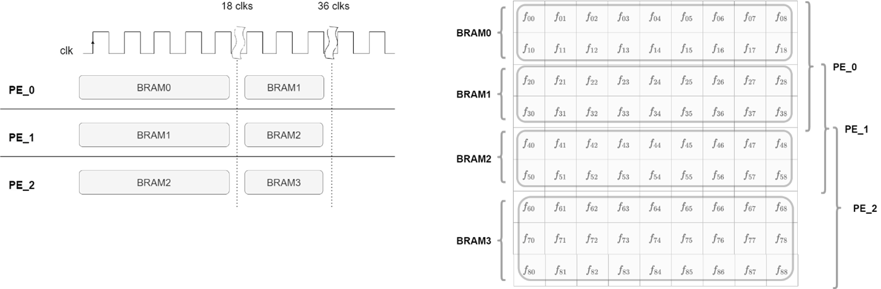
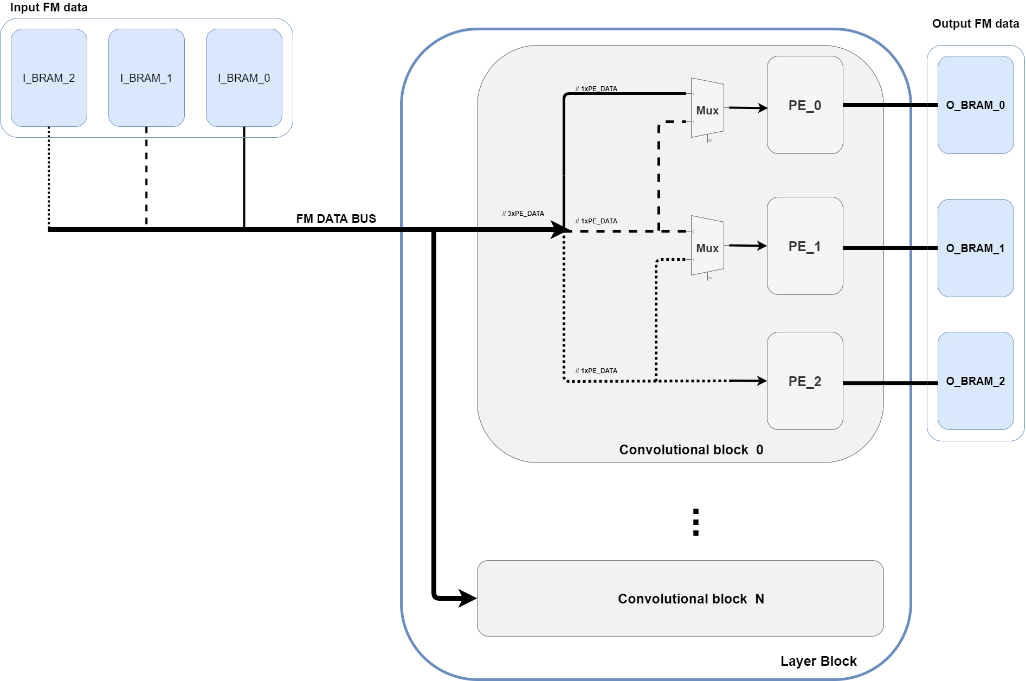
BRAM distribution
A FM of 9x9 with a filter application of 3x3, stride of 1.
Figure shows maximum parallelism application
Three PE blocks in parallel
After 18 clks, each PE reads BRAM values from the following BRAM block
Requires a MUX to control BRAM data flow

Slide 6
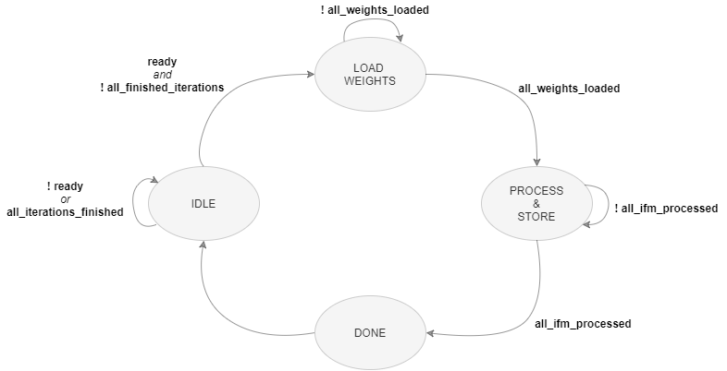
FSM
According to the available resources, the processing required is divided into several iterations.
Each iteration a new set of filters are applied on the IFM.
The processing finished when all filters have been applied to all IFM

Slide 7
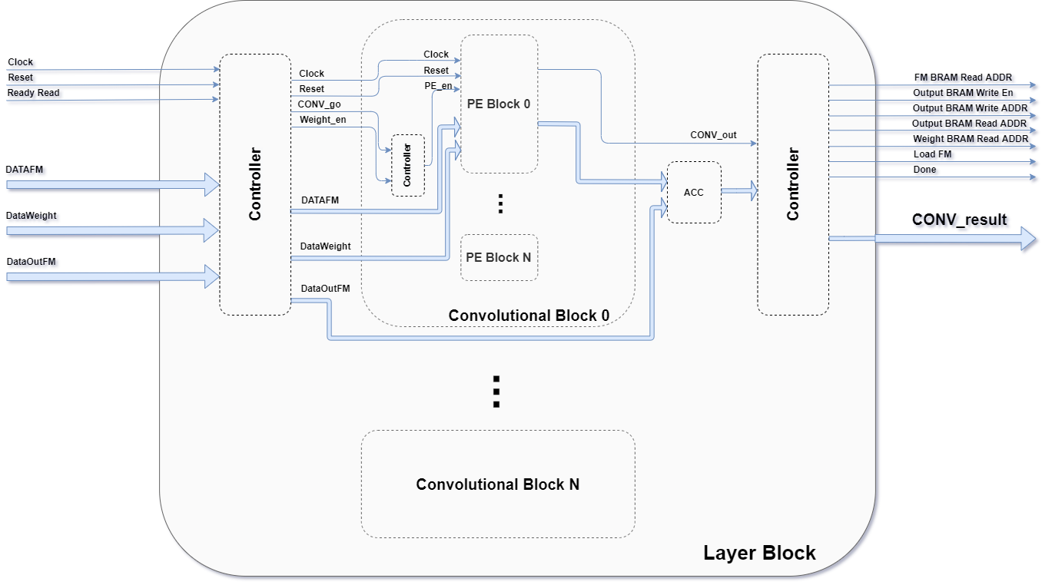
Layer block
Inside the Layer block are possible to instantiate more than one Conv modules.
Each Conv module is associated with a different filter.
All inputs and outputs must be correctly assigned to BRAM blocks, otherwise data collision may occur.

Slide 8
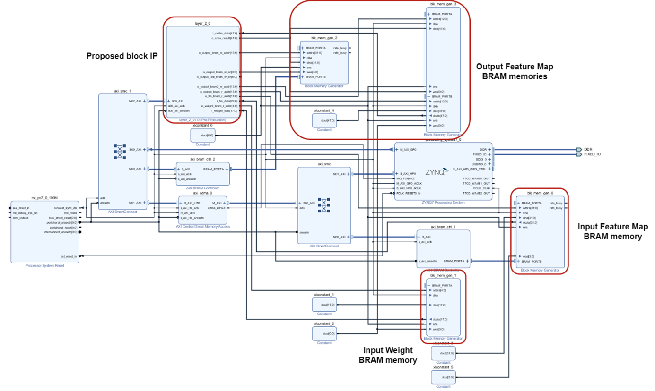
How to use - Block Design for validation
3 Block Rams (Filter, IFM, and OFM )
Developed IP connected to all BRAMS
OFM BRAMS with two ports (convolution with each IFM channel is added)

Slide 9
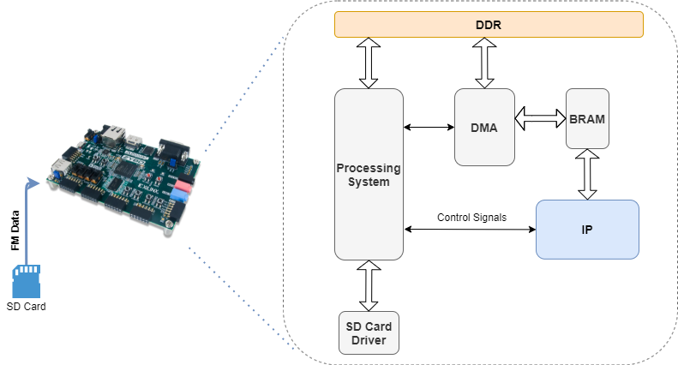
Test Setup
The input image (FM) is stored in an SD card.
The image is sent to DDR through a DMA module.
Then when a signal is sent from the PS to our IP, using an AXI interconnect, the state machine collects data from BRAM block which was previously stored using the DMA module.
After finishing the convolution process, the output FM is sent to SD card.

Slide 10
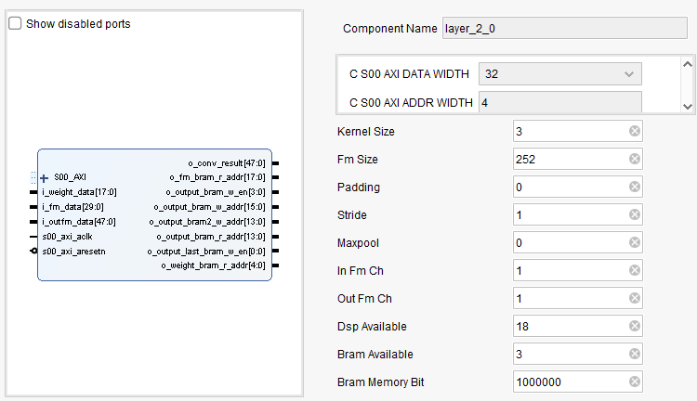
Layer block – IP interface
The parameters Kernel Size, Fm Size, Padding, Stride, Maxpool, In Fm Ch and Out Fm Ch are directly associated with Convolution Neural Network architecture background.
The parameters DSP available, BRAM available and memory bit are related with hardware resources.
Different paremeters values allows higher level of parallelism consuming more resources and increasing computation.
Maxpool parameter is enabled/disabled with 1/0.
In Fm Ch refers to the number of input channels for a given convolution.
Out Fm Ch refers to the number of different filters applying during a convolution.
“Bram Available”: Blocks of Memory available
“Bram Memory Bit”: Capacity (bits) of each block memory

Slide 11
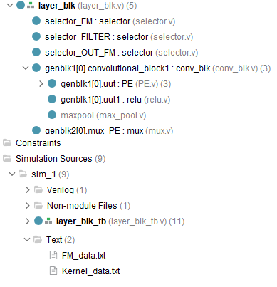
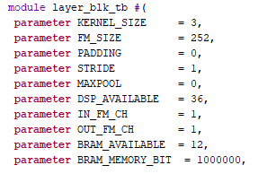
Vivado Simulation
In test bench file, change parameters values
Disable
Each $fwrite saves the convolution output from one filter application.
The output file is located on …/.sim/sim_x/.. dir from vivado project.

Slide 12
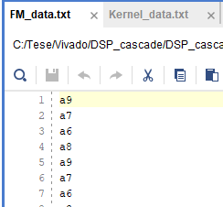
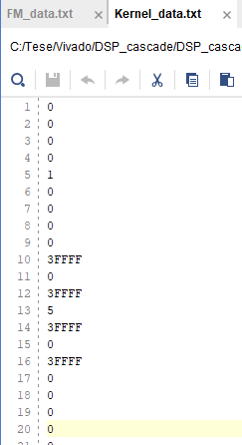
Vivado Simulation
Identity
FM data in hex format
Sharpen
Two different filters, first 9 values for identity filter and following for sharpen filter.

Slide 13
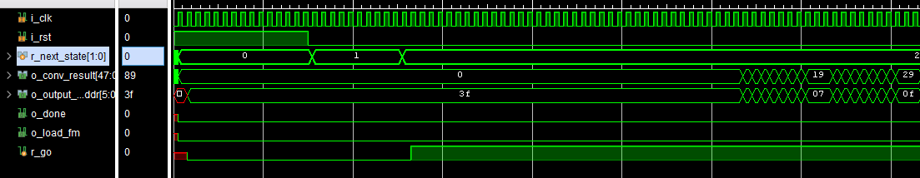
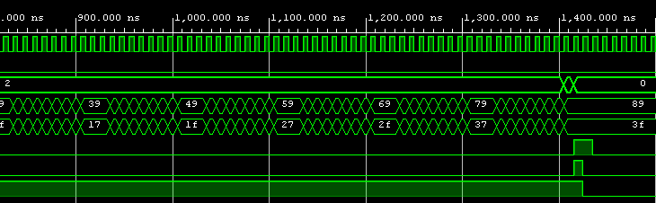
Vivado Simulation
Load Weights
Process and store
FM of 10x10, filter 3x3 with stride 1
R_go enables convolution process
O_done signals the end of processing
Done

Slide 14
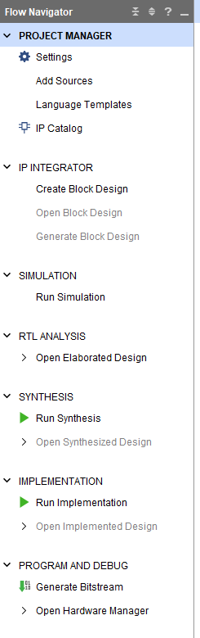
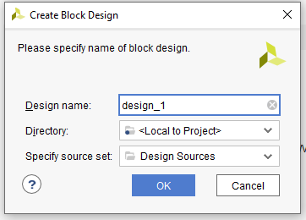

Slide 15
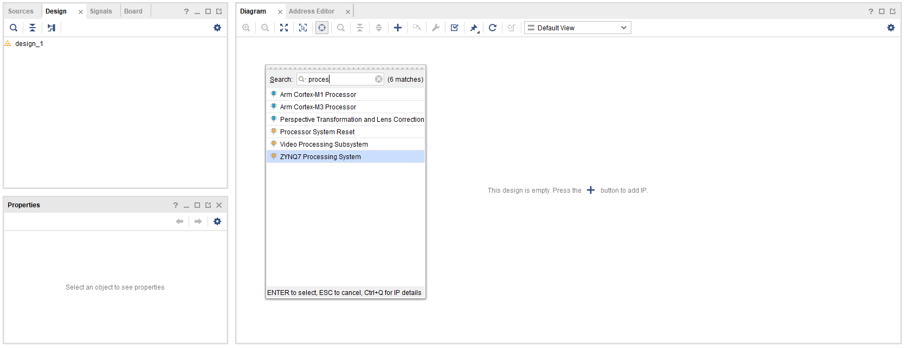
Second, search for PS IP
First, click here

Slide 16
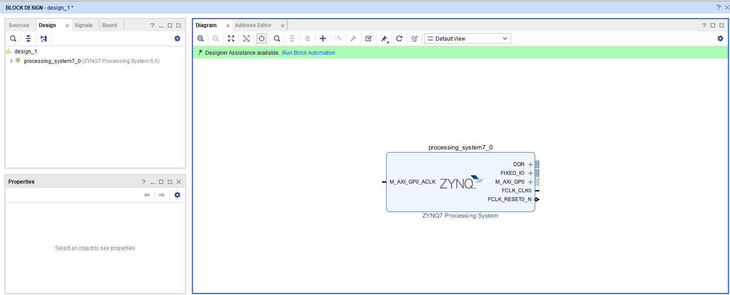
Run Block Automation to connect to DDR and IO

Slide 17
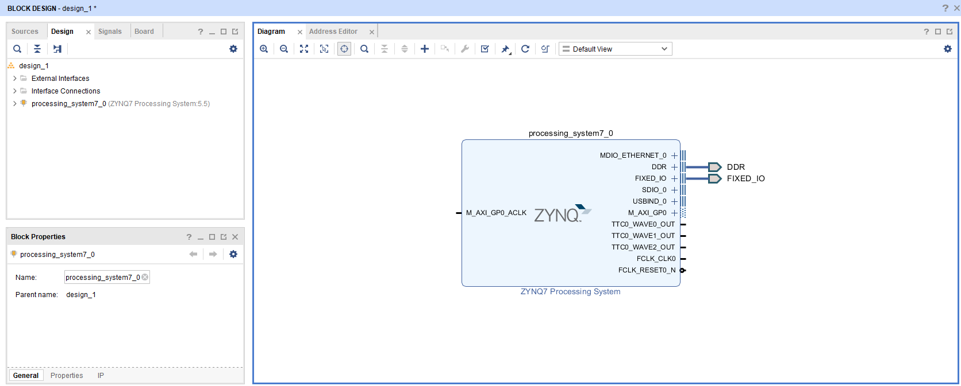

Slide 18
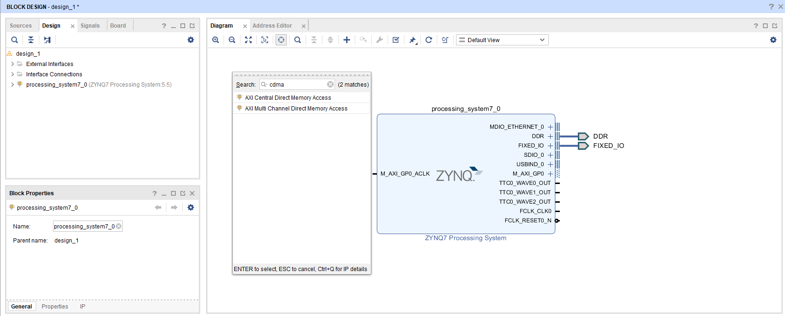
Add CDMA Module to read from input BRAM

Slide 19
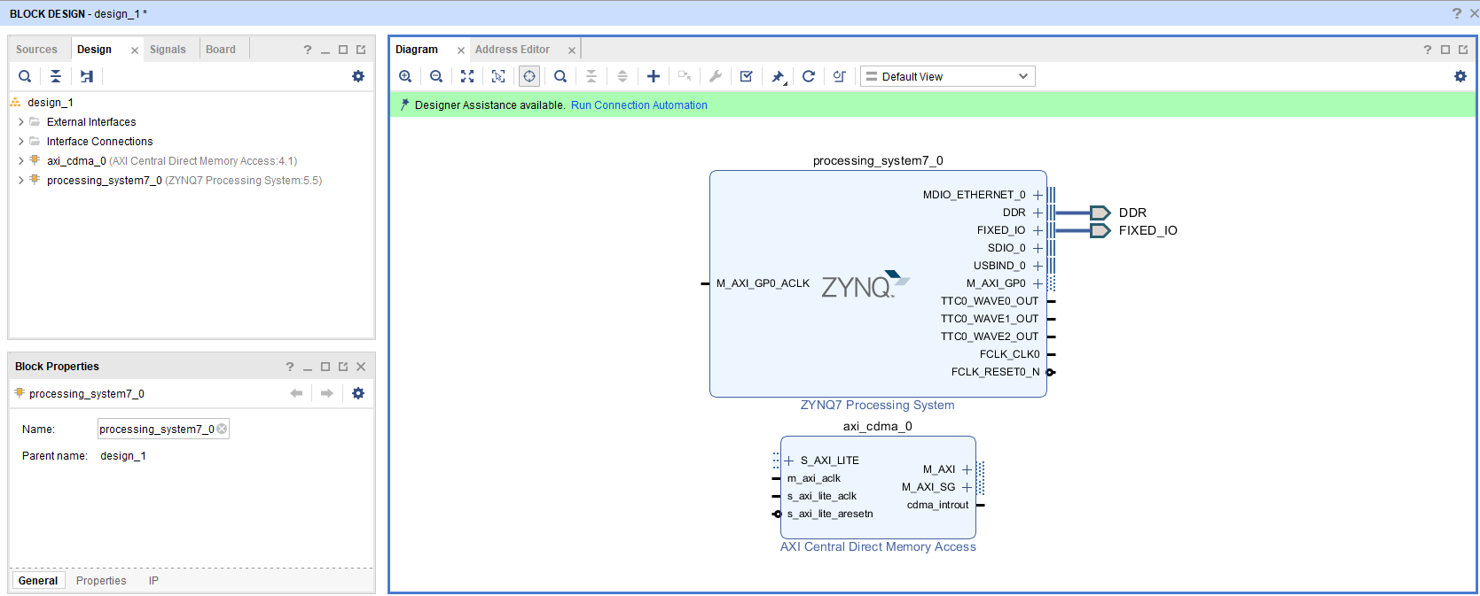
Run Connection Automation to Instantiate System Reset and an AXI Interconnect between PS and CDMA

Slide 20
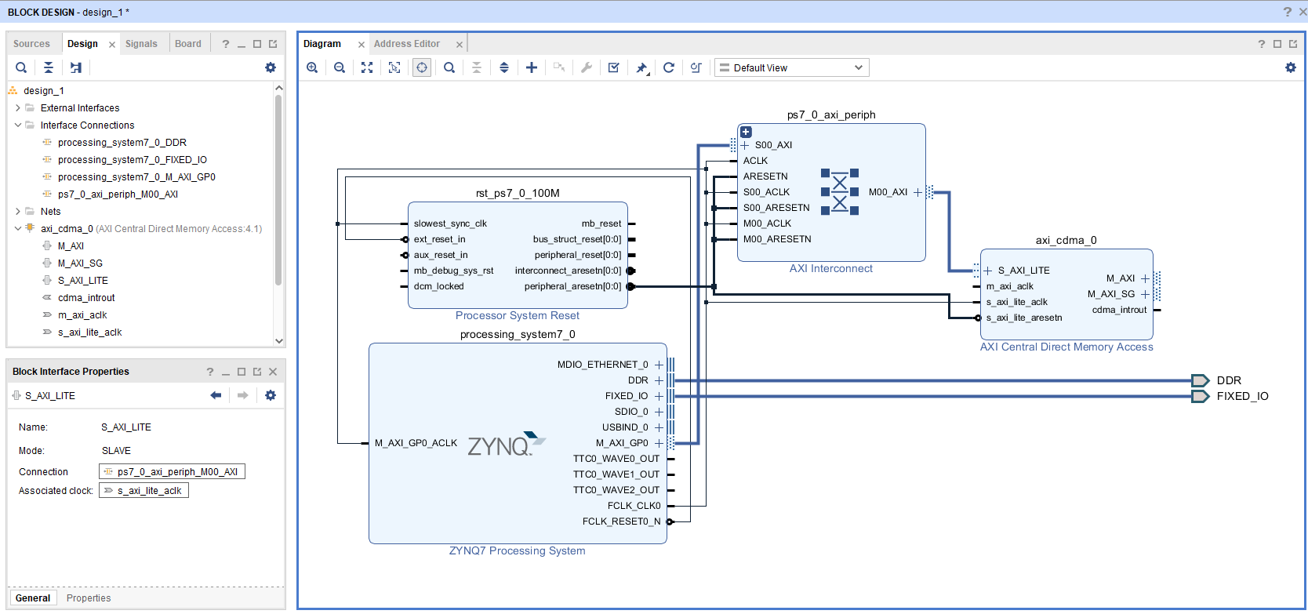

Slide 21
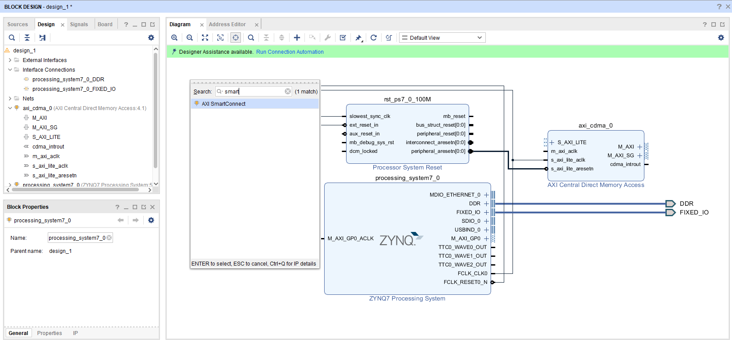
Delete the AXI interconnect and add a Smart connect between CDMA and PS

Slide 22
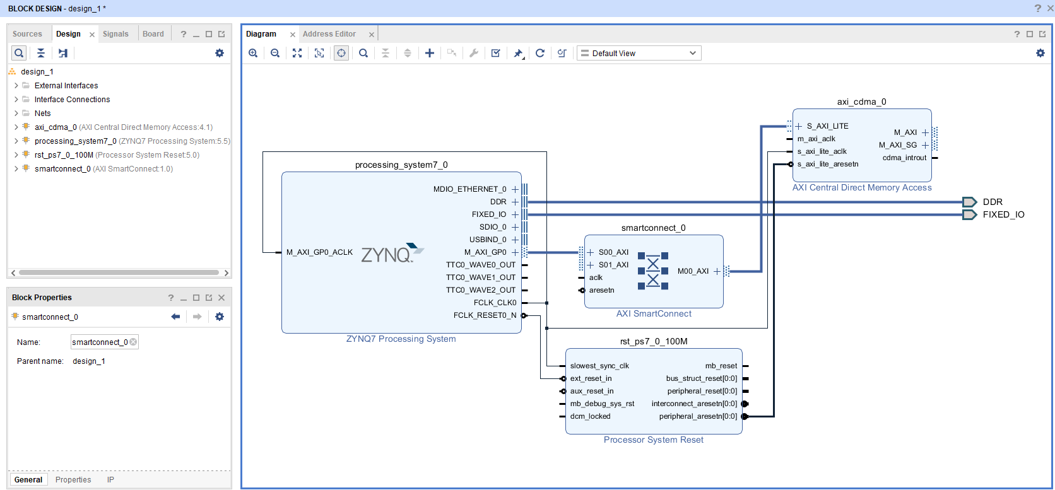
Connect the SmatConnect IP to M_AXI_GP0 on PS and S_AXI_LITE on CDMA

Slide 23
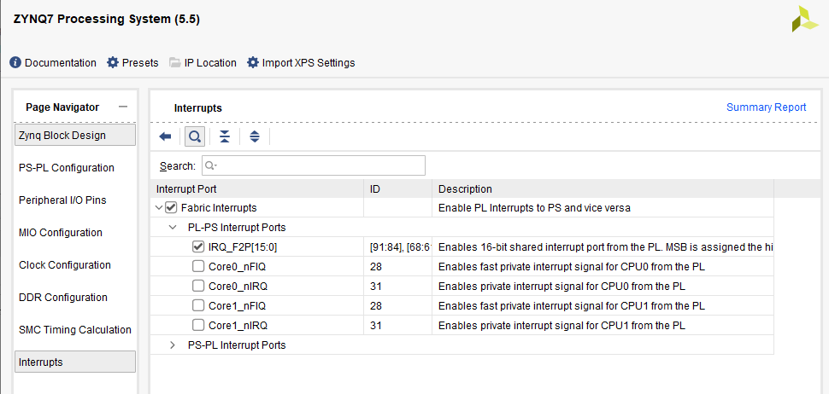
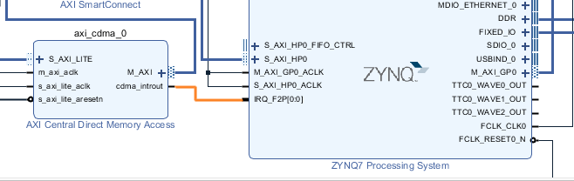
Enable Interrupt on PS an connect to CMDA

Slide 24
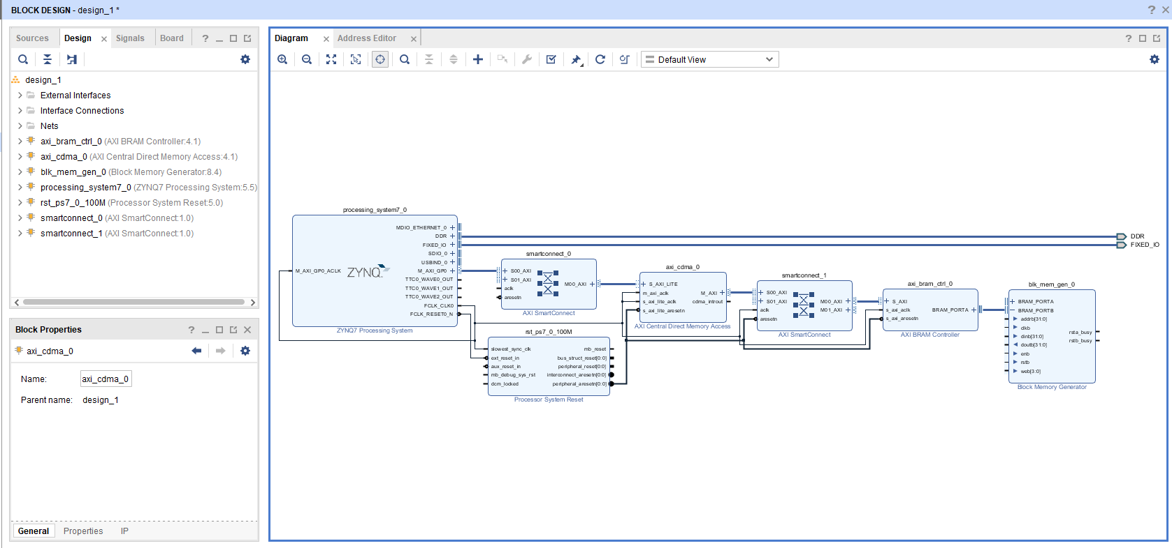
ADD BRAM controller and input BRAM IP
Between BRAM controller and BRAM block add an AXI SmartConnect to correctly established the connection to CDMA

Slide 25
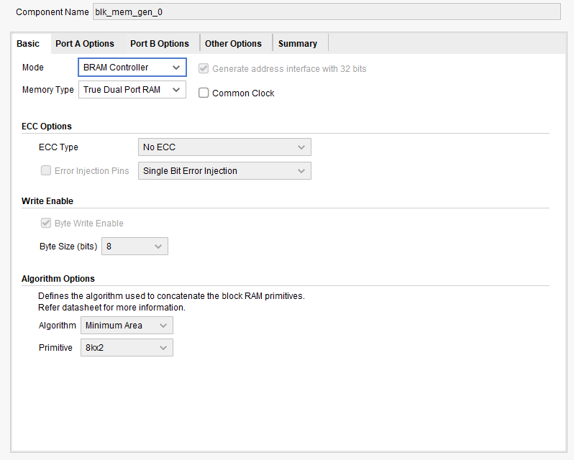
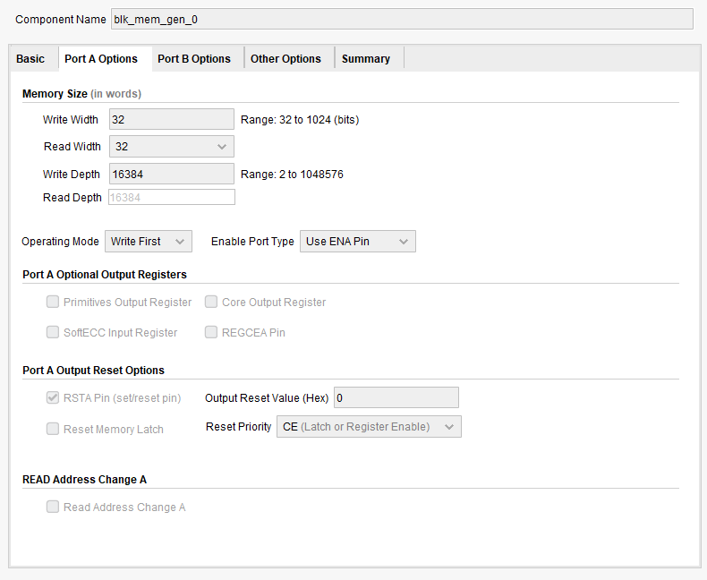
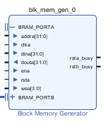
Change the BRAM parameters and BRAM controller for desired example
In this case is using a True Dual port, Port B is connected to CMDA and Port A will be connected to our IP.

Slide 26
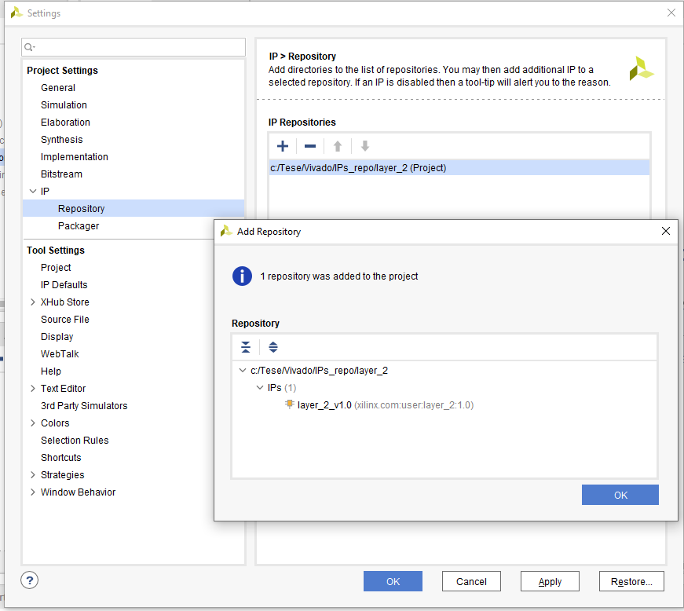
To add a custom IP go to Setting and..
Choose correctly the path where the IP is located
After, add it to IP repository of the current project

Slide 27
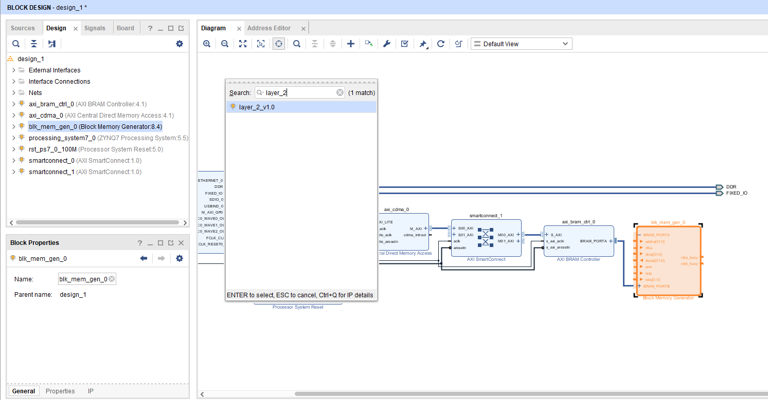
Search for IP on Block Design and add it

Slide 28
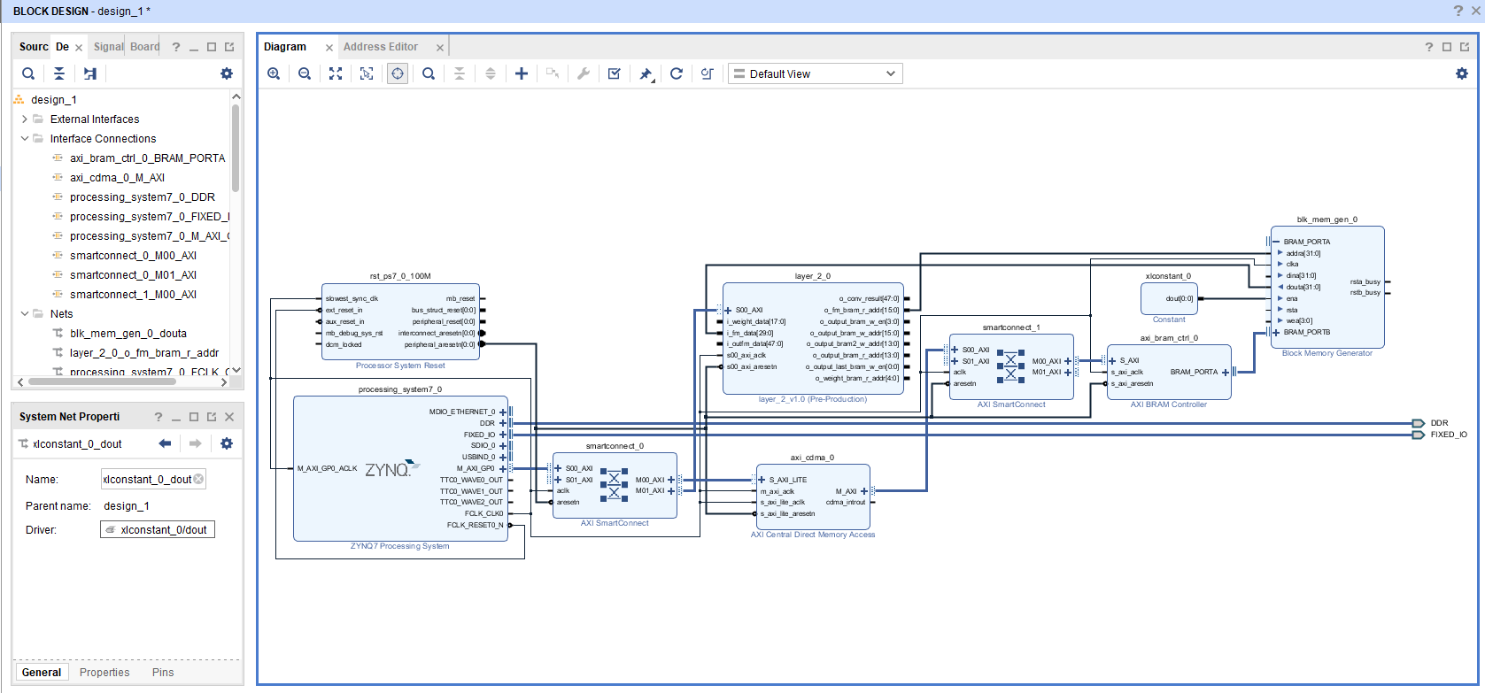
Connect i_fm_data to dout from BRAM
O_fm_bram_r_addr to addr from BRAM
Clka to aclk signal

Slide 29
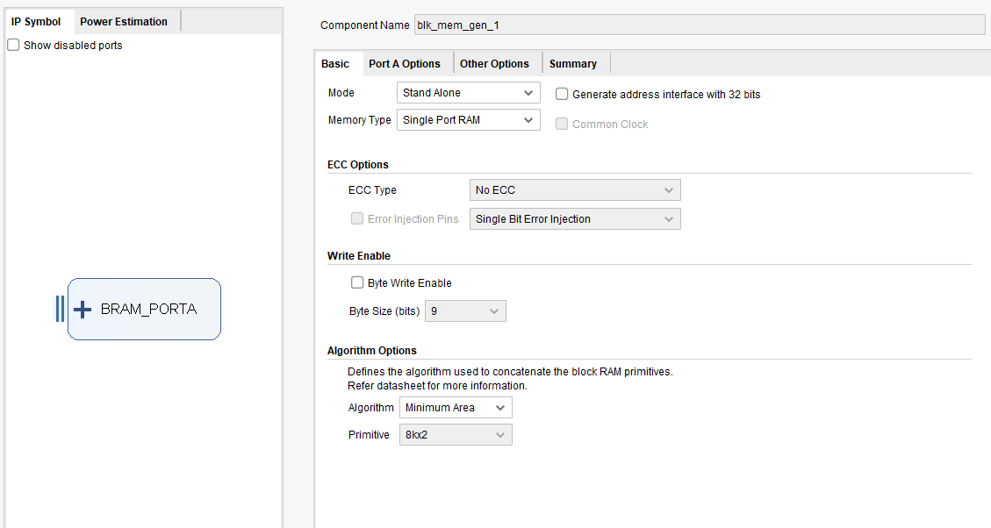
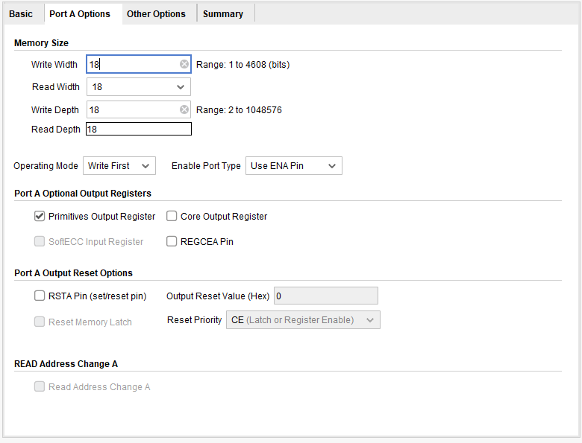
Add a BRAM to hold weight values
For a straightforward implementation, use a COE file to preload the BRAM memory with weight values

Slide 30
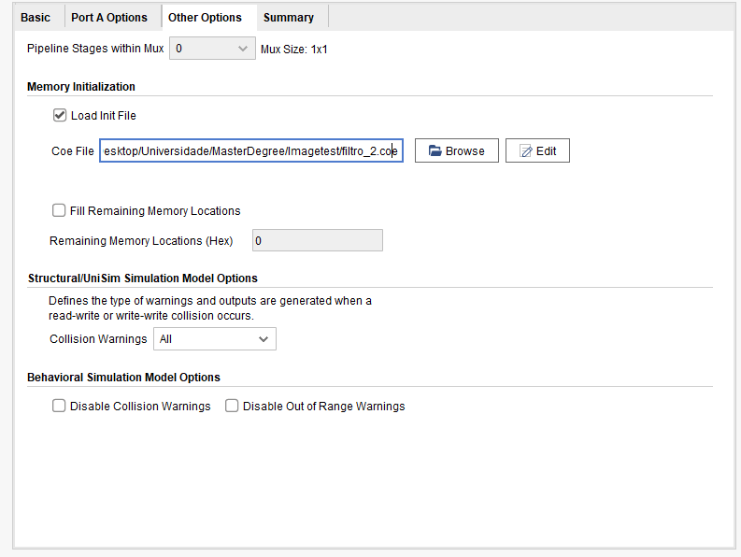
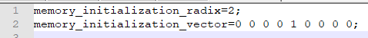
Add a BRAM to hold weight values
Identity filter used in filtro_2.coe file

Slide 31
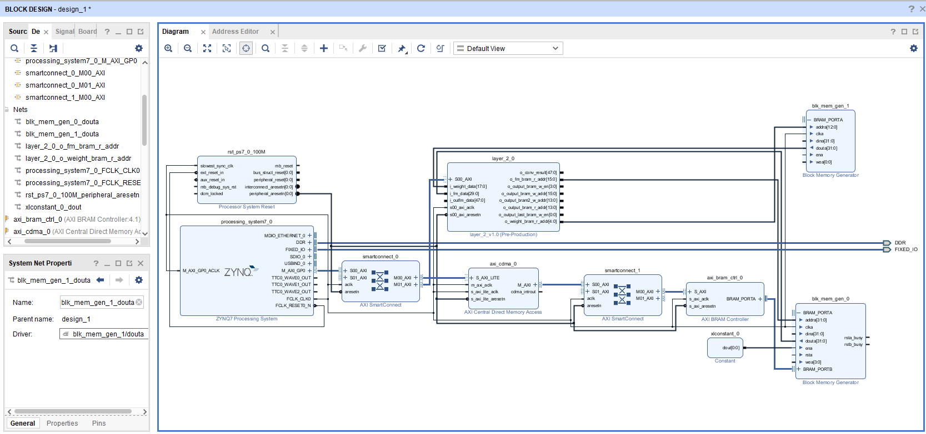
Do the connections to layer IP
Weight data
FM data

Slide 32
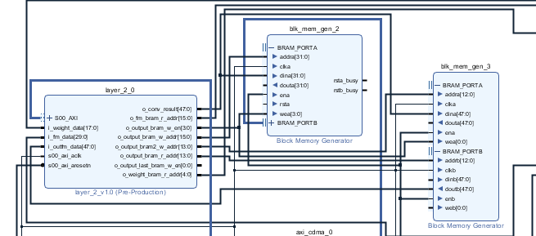
Add two output BRAMs
For a correct work of convolution process it is only necessary one BRAM block, in this case to read back and write on SD card it is required a connection from BRAM block and PS using a BRAM controller.
Correctly connect each input/output from layer ip with BRAM
modules.
In case of incorrect work of BRAM blocks, use const IP to assign 0 value to dinb on blk_mem_gen3

Slide 33
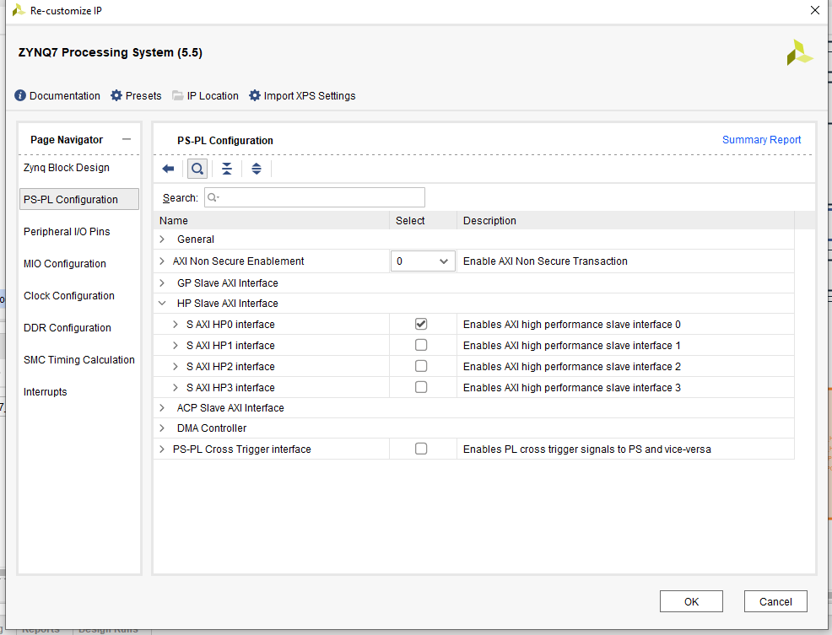
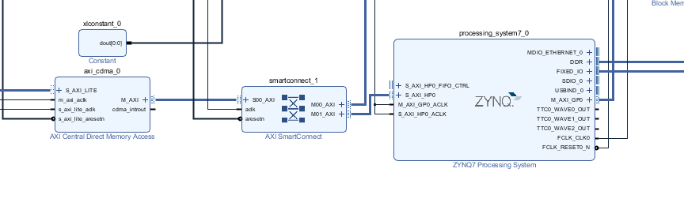
Connect CDMA to High Performance on PS

Slide 34
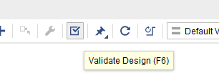
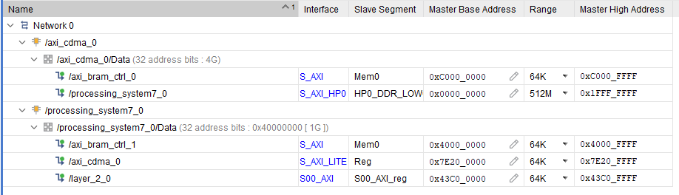
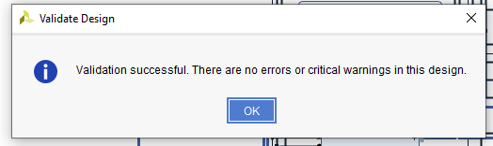
Run Validate Desing
Should appear not errors, if so check address editor tab for possible addresses collisions.
The range value should be updated for different sizes of image being processed. Larger images requires more data consumption.

Slide 35
After that..
Generate output products
Create HDL Wrapper
Run synthesis
Run implementation
Generate bitstream

Slide 36
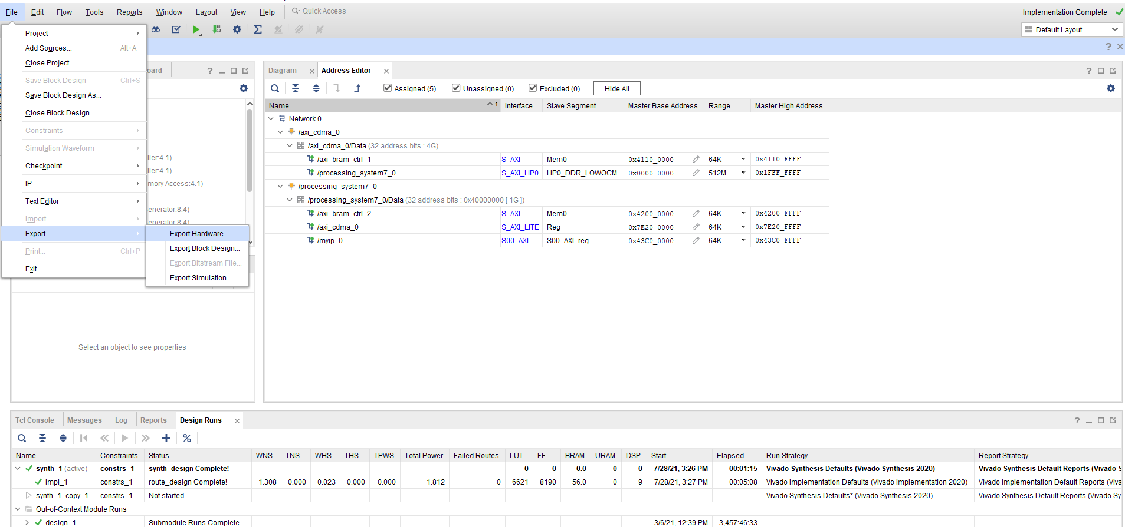
“Export SDK” after bitstream has been generated

Slide 37
Export hardware platform
Platform type = Fixed
Output = Include bitstream
Choose the name of the hardware platform type and the location where the xsa file will be stored – default option is viable
Finish to export the platform

Slide 38
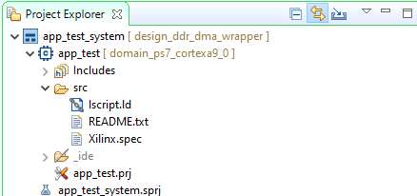
Xilinx Vitis
Create new application project
Select the .xsa file previously generated
Write the name of the application
For the template, select the “Empty Application” option.
The application structure should look similar to this:

Slide 39
Add source files
From path: “C:\Xilinx\Vitis\2020.1\data\embeddedsw\XilinxProcessorIPLib\drivers\axicdma_v4_7\examples” copy to src the file: “xaxicdma_example_simple_intr.c”
This file is used since some functions are already implemented
Nonetheless we need to edit this file.
“xparameters.h” file is where all the macros with the base address for the DDR memory and the BRAM controllers are defined.

Slide 40
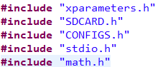
Includes
Make sure to include this set of libraries. As we pretend to transfer data from the Sdcard to the DDR memory, some functions will be used for that purpose.
Depending on the data size used inside the hardware module, the functions may need to be edited to work with a certain data width.

Slide 41

Program the FPGA
Select “Program the FPGA”
Select the correct bitstream and then select “Program”
Before Run the application you may want to setup the connection to the target platform first.
In this case, PuTTY was used
Set the port used and the correct baudrate

Slide 42



Run the application
Click on the created application
Select “Run configurations” from the top-bar
Select “System debugger”
Hit run. In the terminal the values sent from the DDR to the BRAM will be displayed as well as the output of processing.
Depending on the IFM provided, the output values will vary.

